Slide 1


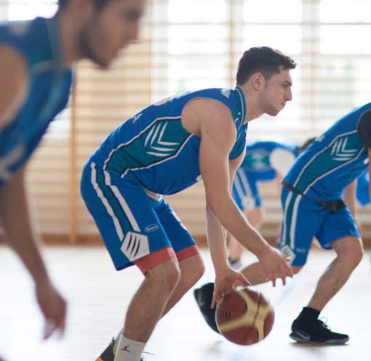

SAFE
VISTULA
2022/2023

Slide 2

Emergency Telephone Numbers
If you feel threatened, something dangerous happened to you or you witnessed a crime/accident, immediately call:
112 (General Emergency Number)
or
- 997 (Police)
998 (Fire Brigade)
999 (Ambulance)
986 (City Guard)
Campus Emergency Number
+48 501 556 557

Slide 3


Remember that the following misdemeanors are subject to fine:
Consumption of alcohol in certain places eg. universities, dormitories, parks, buses etc. (100-500 PLN).
Smoking cigarettes, also electronic, in forbidden places (500 PLN).
Disrupting of peace (after 10pm), littering, public manifestation of socially unacceptable behaviour (100-500 PLN).
Crossing the street on red light (200 PLN). Crossing the street using cellphone (300PLN).
Using public transportation without a valid ticket (266 PLN).
Grupa Uczelni Vistula
Praktyczna wiedza. Biznesowe podejście. Globalne możliwości.

Slide 4

In order to feel safe in Warsaw:
Avoid isolated, dark areas, especially in the evenings or at nights.
Carry your personal/student ID card.
Save emergency numbers in your mobile phone, which should be protected by security lock. Keep a record of the unique IMEI number of your device (*#06#).
Always keep your valuables close to you, especially in public places and while using public transportation.
Do not carry large amounts of money with you.
Protect your bike – take a picture of it and keep a note of its serial number. Lock it every time and leave it only in secure, well-lit places.
Keep your family/friends updated on your plans and your contact information
Do not be an open book on social media.
Avoid taking quick decisions concerning renting a flat.
Go to parties or clubs/pubs with people you trust and constantly keep an eye on your drink.
Never avoid your company or leave the place alone when you feel drunk.
Remember that Poland is not Holland and drugs are strictly prohibited. Possesion of the smallest amount of drugs is an offence ( 3 years in prison).
Grupa Uczelni Vistula
Praktyczna wiedza. Biznesowe podejście. Globalne możliwości.

Slide 5

Security at Vistula
Get acquainted with rules and regulations regarding your stay at Vistula, as well as with the Security Procedures displayed on the boards in various places of the University and on its website www.vistula.edu.pl/en/students/safety-on-vistula
Report any suspicious activity to the security staff.
Never ignore security alarms and in case of evacuation leave the premises by nearest exit door (do not use elevators).
Remember that smoking is allowed only at the designated area.
Drinking and possession of alcohol is strictly prohibited.
Always carry your student ID card and proof of medical insurance.
The university doctor is available in room 24 on weekdays (except for Thursdays), between 9-11am. You can make an appointment with an English speaking doctor for on-line consultations visiting https://book.vistula.edu.pl/. The psychologist is available on Thursdays between 3pm-5pm. If there is a need of first aid and the use of AED defibrillator, the list of trained staff is at the reception /security desk in the lobby. You can also get basic medicine there, as well as a thermometer.
Grupa Uczelni Vistula
Praktyczna wiedza. Biznesowe podejście. Globalne możliwości.

Slide 6

If you are a victim or witness a crime at Vistula, feel threatened, immediately notify:
Mr Michał Jasiński
Rector’s Proxy for Security Affairs
+48 501 556 557
m.jasinski@vistula.edu.pl
Office hours in room 207:
Mondays and Wednesdays 11 am – 2pm
or at a different time agreed upon via phone or e-mail.
Meetings with the Proxy take place in a confidential environment. In each case an appropriate mode of action is agreed upon with the person concerned.
Grupa Uczelni Vistula
Praktyczna wiedza. Biznesowe podejście. Globalne możliwości.

Slide 7


Thanks for your attention.
Michał Jasiński
Rector’s Proxy for Security Affairs
Akademia Finansów i Biznesu Vistula Szkoła Główna Turystyki i Hotelarstwa
ul. Stokłosy 3, 02-787 Warszawa
(wejście od stacji Metro Stokłosy)
Więcej na: www.vistula.edu.pl
Grupa Uczelni Vistula
Praktyczna wiedza. Biznesowe podejście. Globalne możliwości.

